Slide 1
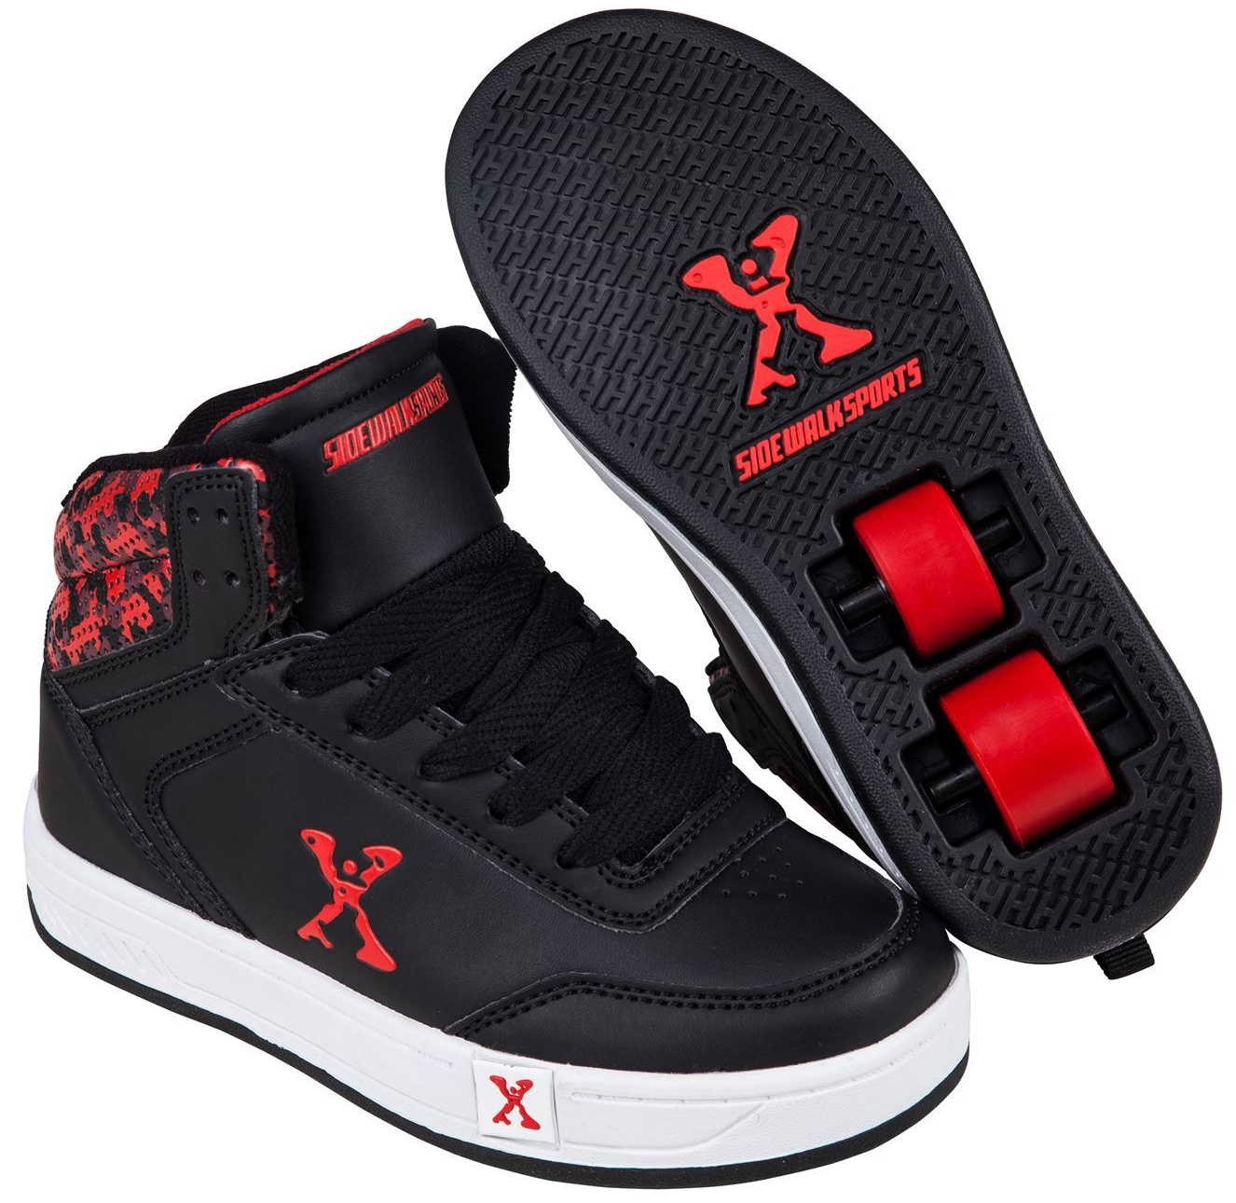
Daily Review
CFU 1
Which method of friction reduction is being used?
In situations where friction is reduced, you need to:
Identify which method is being used.
Explain how friction is being reduced in that situation.
This is an example of ________. The wheels in the shoes roll, which produces _____________ than pushing or sliding.
CFU 2
How does this method work in this situation?
Reminders:
Lubrication makes things slippery Balls and rollers make things roll, which produces less friction than pushing or sliding Levitation reduces contact between surface Streamlined objects are smooth and rounded

Slide 2
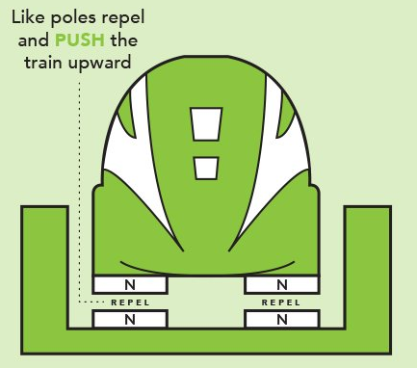
Daily Review
CFU 1
Which method of friction reduction is being used?
In situations where friction is reduced, you need to:
Identify which method is being used.
Explain how friction is being reduced in that situation.
This is an example of ___________. The magnets push the train up, eliminating its __________ with the rails.
CFU 2
How does this method work in this situation?
Reminders:
Lubrication makes things slippery Balls and rollers make things roll, which produces less friction than pushing or sliding Levitation reduces contact between surface Streamlined objects are smooth and rounded

Slide 3
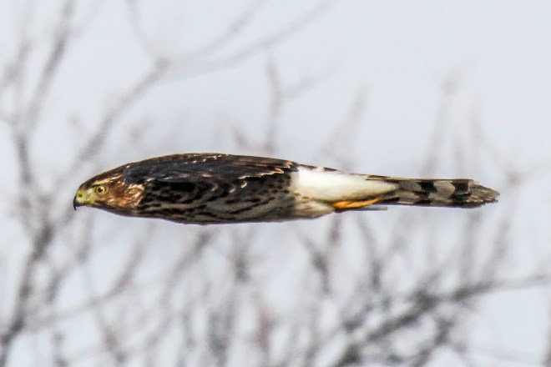
Daily Review
CFU 1
Which method of friction reduction is being used?
In situations where friction is reduced, you need to:
Identify which method is being used.
Explain how friction is being reduced in that situation.
This is an example of ___________. The hawk is smooth and rounded, _______________ between it and the air.
CFU 2
How does this method work in this situation?
Reminders:
Lubrication makes things slippery Balls and rollers make things roll, which produces less friction than pushing or sliding Levitation reduces contact between surface Streamlined objects are smooth and rounded

Slide 4
Gravity Year 7 Science

Slide 5
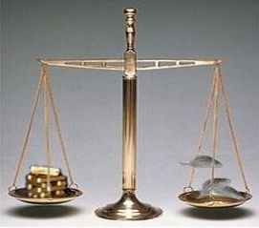
Learning Objectives
CFU 1
Which two things do you need to be able to explain the difference between?
Explain the difference between mass and weight.
Describe gravity and what affects its strength.
CFU 2
What two things do you need to be able to describe?
Activate Prior Knowledge
Which is heavier: a kilogram of gold or a kilogram of feathers?
Your friend ‘borrows’ your kilogram of gold and takes it to the Moon, leaving the feathers behind. Which one is heavier now?

Slide 6
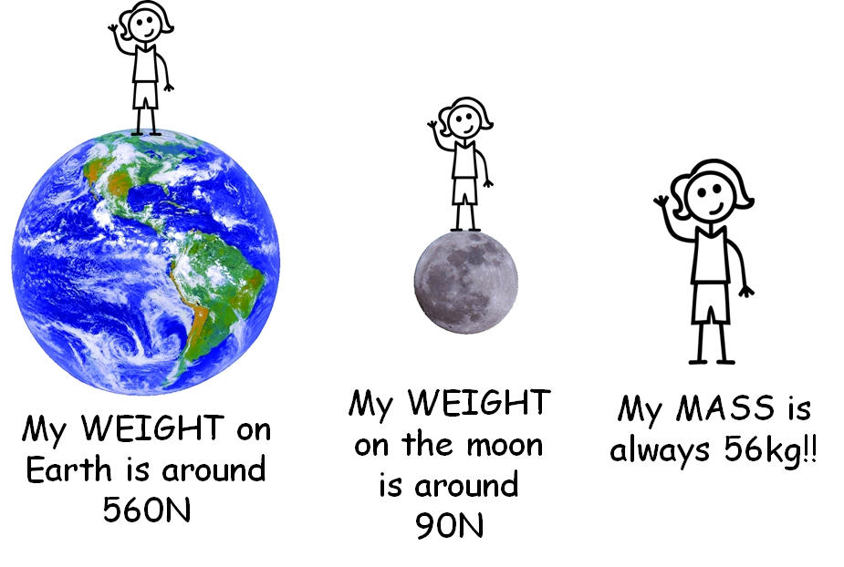
Concept Development
CFU 1
True or False: mass and weight are different, but they are measured using the same units.
Mass vs. Weight
People often talk about mass and weight as if they’re the same thing – but they’re actually quite different!
Mass:
Is the amount of _________ (‘stuff’) an object contains
Is measured in ________ (kg)
Stays the same, even on different planets
Weight:
Is the force of a planet’s _____ on an object
Is measured in _________ (N)
Can change
CFU 2
When your friend takes your gold to the moon, what changes about it?
Mass Weight | Both Neither

Slide 7
Concept Development
CFU 1
What does an object need to have to be pulled by gravity?
Gravity
Gravity is a non-contact force that pulls objects with mass together.
The strength of gravity depends on:
The _______ of the objects
The __________ between the objects
CFU 2
Which two things does gravity depend on?
Vocabulary
mass (noun) the amount of matter (‘stuff’) an object contains weight (noun) the force of a planet’s pull on an object

Slide 8
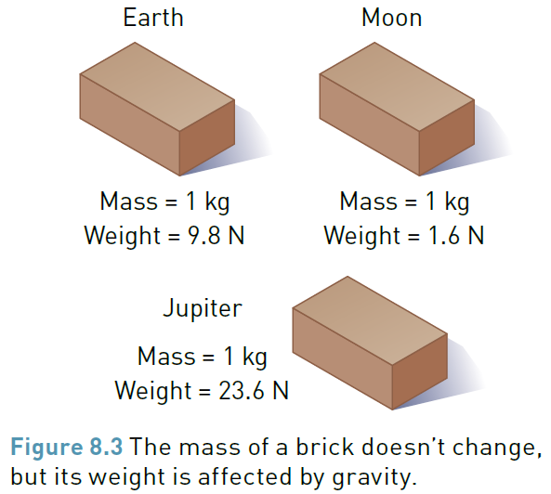
Concept Development
CFU 1
Which object is pulled harder by gravity: a person or a cat? Why?
Gravity
Gravity is a non-contact force that pulls objects with mass together.
The strength of gravity depends on:
The mass of the objects: objects with more mass pull harder and get pulled ________.
CFU 2
Based on the picture, does Earth have more or less mass than Jupiter? How do you know?
Vocabulary
mass (noun) the amount of matter (‘stuff’) an object contains weight (noun) the force of a planet’s pull on an object

Slide 9
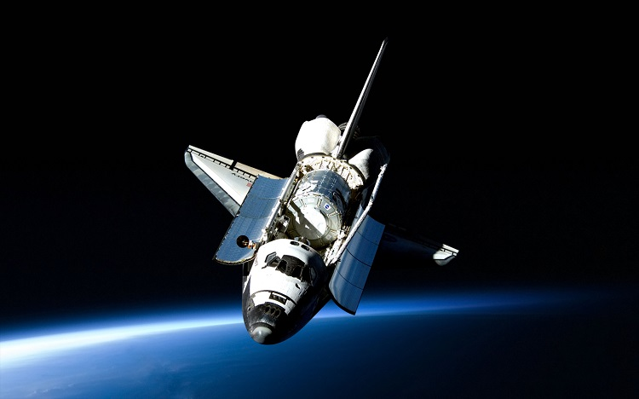
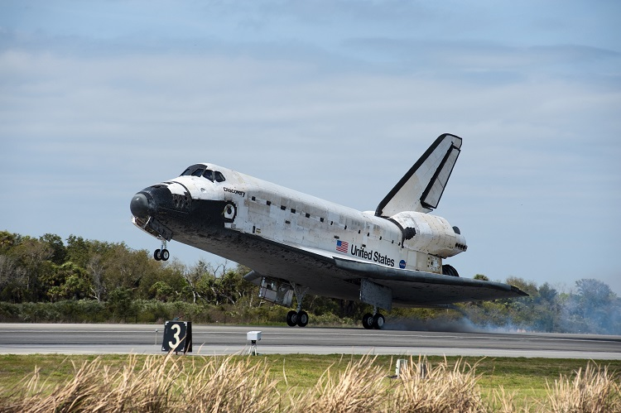
Concept Development
CFU 1
Getting closer to an object makes the gravitational pull between you and it: Weaker Unchanged Stronger
Gravity
Gravity is a non-contact force that pulls objects with mass together.
The strength of gravity depends on:
The distance between the objects: the further away the objects are, the _________ the pull will be.
CFU 2
In which picture is the space shuttle experiencing a stronger pull? How do you know?
Vocabulary
mass (noun) the amount of matter (‘stuff’) an object contains weight (noun) the force of a planet’s pull on an object

Slide 10
Skill Development / Guided Practice
CFU 1
What three things do you need to consider when comparing gravitational force?
Comparing Gravity
When comparing the force of gravity on two objects, you need to consider:
The mass of the objects: more mass = more gravity
The mass of the planets: more mass = more gravity
The distance between the objects: more distance = less gravity
Then state which object is pulled more (or less) by gravity and explain why.
CFU 2
What two things do you need to include in your final answer?
Vocabulary
mass (noun) the amount of matter (‘stuff’) an object contains gravity (noun) a non-contact force that pulls objects with mass together
The brick on the Earth is pulled ______ by gravity because the Earth has more ______ than the Moon.

Slide 11
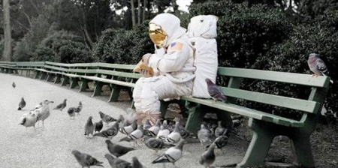
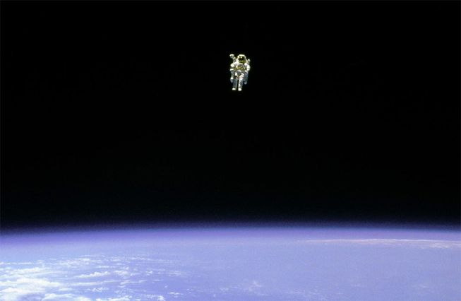
Skill Development / Guided Practice
CFU 1
Is the mass of the two objects different?
Comparing Gravity
Consider the mass of the objects: more mass = more gravity
Consider the mass of the planets: more mass = more gravity
Consider the distance between the objects: more distance = less gravity
State which object is pulled more (or less) by gravity and explain why.
CFU 2
Is the mass of the two planets different?
CFU 3
Is the distance between the two objects different?
Vocabulary
mass (noun) the amount of matter (‘stuff’) an object contains gravity (noun) a non-contact force that pulls objects with mass together
The ________ is pulled ____ by gravity because…

Slide 12
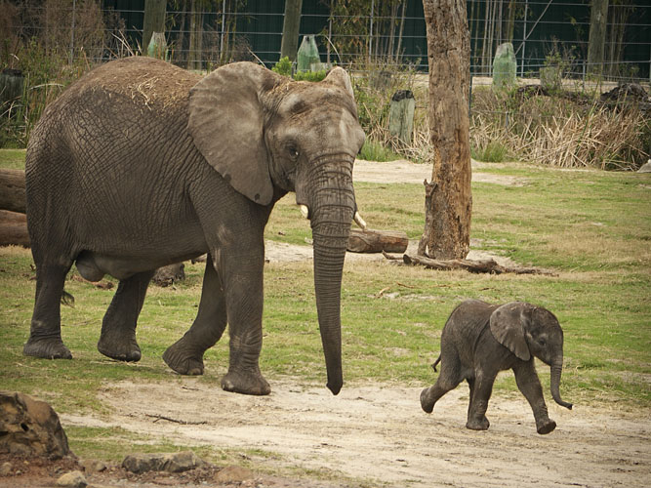
Skill Development / Guided Practice
CFU 1
Is the mass of the two objects different?
Comparing Gravity
Consider the mass of the objects: more mass = more gravity
Consider the mass of the planets: more mass = more gravity
Consider the distance between the objects: more distance = less gravity
State which object is pulled more (or less) by gravity and explain why.
CFU 2
Is the mass of the two planets different?
CFU 3
Is the distance between the two objects different?
Vocabulary
mass (noun) the amount of matter (‘stuff’) an object contains gravity (noun) a non-contact force that pulls objects with mass together
The ________ is pulled ____ by gravity because…

Slide 13
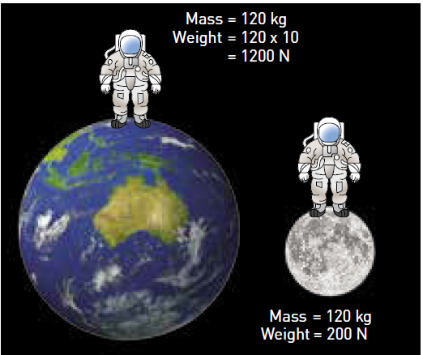
Skill Development / Guided Practice
CFU 1
Is the mass of the two objects different?
Comparing Gravity
Consider the mass of the objects: more mass = more gravity
Consider the mass of the planets: more mass = more gravity
Consider the distance between the objects: more distance = less gravity
State which object is pulled more (or less) by gravity and explain why.
CFU 2
Is the mass of the two planets different?
CFU 3
Is the distance between the two objects different?
Vocabulary
mass (noun) the amount of matter (‘stuff’) an object contains gravity (noun) a non-contact force that pulls objects with mass together
The ________ is pulled ____ by gravity because…

Slide 14
Relevance
Understanding gravity will help you understand:
How you move when you jump or fall… or just sit in your chair
How things move when you throw or drop them (this is called projectile motion)
How planets orbit around the sun
How tides work
Stars, black holes and other cool space stuff

Slide 15
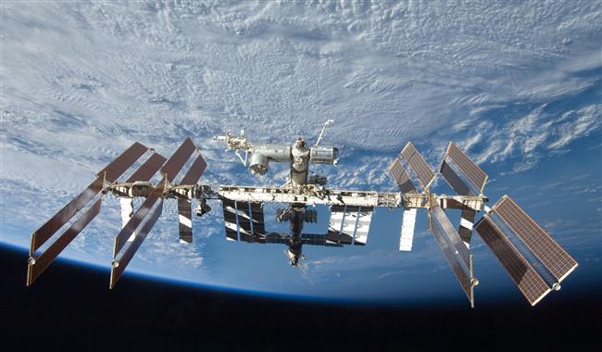
Skill Closure
Complete each of the following statements with ‘mass’ or ‘weight’.
_____ is measured in kg.
_____ is a force.
_____ does not change, even on different planets.
_____ is affected by the distance between two objects.
State which object is pulled more (or less) by gravity and explain why.
An astronaut in training on Earth or an astronaut orbiting the Earth in the ISS
You or your chair
A kilogram of feathers on Earth or a kilogram of feathers on the Moon

Slide 16
Independent Practice
Answer the following questions in your book or device.
When skydivers step out of an aeroplane they begin to fall towards the Earth. What causes this?
What is the difference between mass and weight?
True or false: the pull of gravity is stronger on an elephant than on a feather. Explain your answer.
Your mass at a given time remains the same, regardless of gravity. Your weight, however, changes as a result of gravity.
Why isn’t the mass of any object changed by gravity?
Why does the weight of an object sometimes change?
Vocabulary
mass (noun) the amount of matter (‘stuff’) an object contains gravity (noun) a non-contact force that pulls objects with mass together weight (noun) the force of a planet’s pull on an object

